Slide 1

BS – 101 Engineering Physics
Lecture – 14
Engr. Safee Ullah

Slide 2
Comparison of a Semiconductor Atom to a Conductor Atom
Silicon is a semiconductor and copper is a conductor. Bohr diagrams of the silicon atom and the copper atom are shown in Figure. Notice that the core of the silicon atom has a net charge of 4 (14 protons 10 electrons) and the core of the copper atom has a net charge of 1 (29 protons 28 electrons). The core includes everything except the valence electrons.

Slide 3
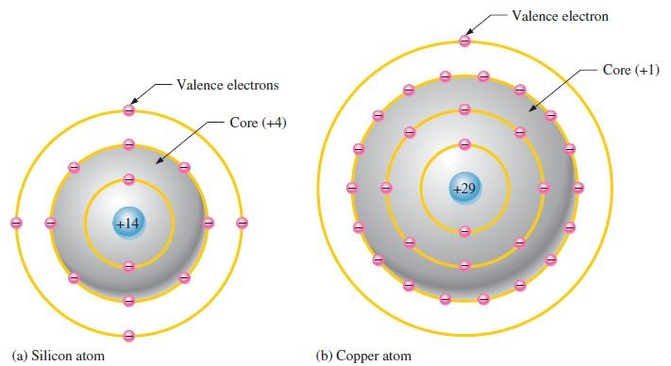
Comparison of a Semiconductor Atom to a Conductor Atom (Contd.)

Slide 4
Comparison of a Semiconductor Atom to a Conductor Atom (Contd.)
The valence electron in the copper atom “feels” an attractive force of 1 compared to a valence electron in the silicon atom which “feels” an attractive force of 4. Therefore, there is more force trying to hold a valence electron to the atom in silicon than in copper.
The copper’s valence electron is in the fourth shell, which is a greater distance from its nucleus than the silicon’s valence electron in the third shell.
Recall that electrons farthest from the nucleus have the most energy. The valence electron in copper has more energy than the valence electron in silicon.
This means that it is easier for valence electrons in copper to acquire enough additional energy to escape from their atoms and become free electrons than it is in silicon.
In fact, large numbers of valence electrons in copper already have sufficient energy to be free electrons at normal room temperature.

Slide 5
Silicon and Germanium
The atomic structures of silicon and germanium are compared in Figure.
Silicon is used in diodes, transistors, integrated circuits, and other semiconductor devices.
Notice that both silicon and germanium have the characteristic four valence electrons.

Slide 6
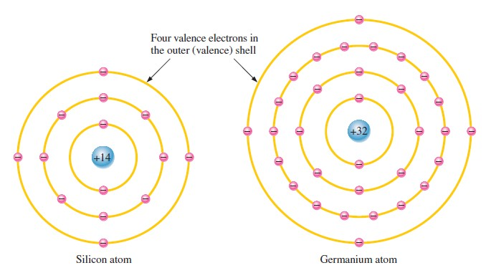
Silicon and Germanium (Contd.)

Slide 7
Silicon and Germanium (Contd.)
The valence electrons in germanium are in the fourth shell while those in silicon are in the third shell, closer to the nucleus.
This means that the germanium valence electrons are at higher energy levels than those in silicon and, therefore, require a smaller amount of additional energy to escape from the atom.
This property makes germanium more unstable at high temperatures and results in excessive reverse current.
This is why silicon is a more widely used semiconductive material.

Slide 8
Covalent Bonds
Figure shows how each silicon atom positions itself with four adjacent silicon atoms to form a silicon crystal.
A silicon (Si) atom with its four valence electrons shares an electron with each of its four neighbors.
This effectively creates eight shared valence electrons for each atom and produces a state of chemical stability.

Slide 9
Covalent Bonds (Contd.)
Also, this sharing of valence electrons produces the covalent bonds that hold the atoms together; each valence electron is attracted equally by the two adjacent atoms which share it.
Covalent bonding in an intrinsic silicon crystal is shown in Figure.
An intrinsic crystal is one that has no impurities.
Covalent bonding for germanium is similar because it also has four valence electrons.

Slide 10
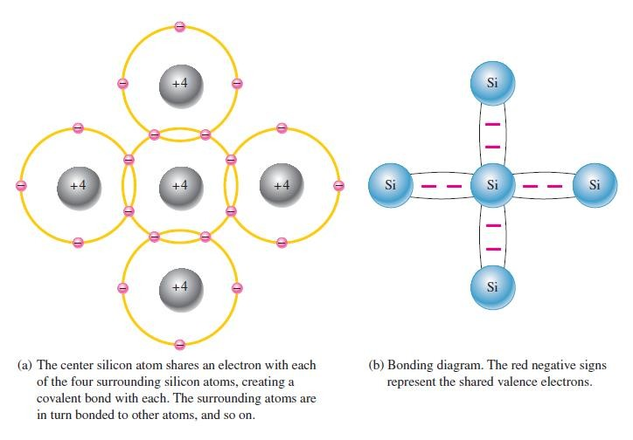
Covalent Bonds (Contd.)

Slide 11
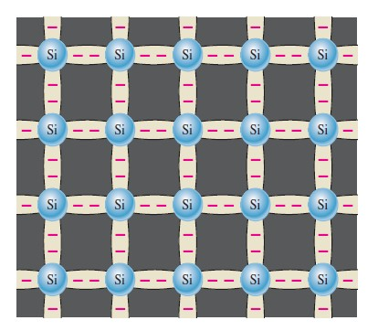
Covalent Bonds (Contd.)

Slide 12
Energy Bands
As you have learned, the electrons of an atom can exist only within prescribed energy bands.
Each shell around the nucleus corresponds to a
certain adjacent
energy band and is separated from shells by band gaps, in which no
electrons can exist.
Figure shows the energy band diagram for an unexcited (no external energy such as heat) atom in a pure silicon crystal. This condition occurs only at a temperature of absolute 0 Kelvin.

Slide 13
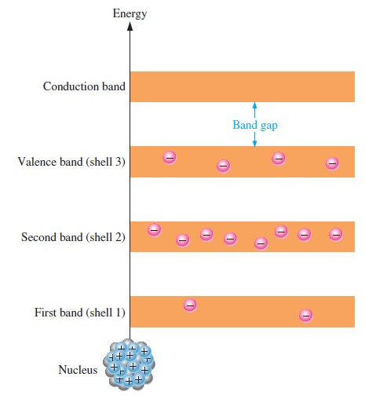
Energy band diagram for an unexcited atom in a pure (intrinsic) silicon crystal.

Slide 14
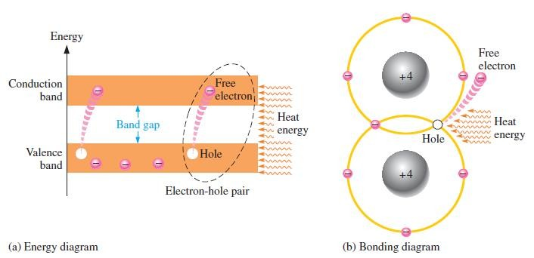
Conduction Electrons and Holes
An intrinsic (pure) silicon crystal at room temperature has sufficient heat (thermal) energy for some valence electrons to jump the gap from the valence band into the conduction band, becoming free electrons. Free electrons are also called conduction electrons. This is illustrated in the energy diagram of Figure (a) and in the bonding diagram of Figure (b).

Slide 15
Conduction Electrons and Holes (Contd.)
When an electron jumps to the conduction band, a vacancy is left in
the valence band within the crystal. This vacancy is called a hole.
For every electron raised to the conduction band by external energy, there is one hole left in the valence band, creating what is called an electron-hole pair.
Recombination occurs when a conduction-band electron loses
energy and falls back into a hole in the valence band.
To summarize, a piece of intrinsic silicon at room temperature has, at any instant, a number of conduction-band (free) electrons that are unattached to any atom and are essentially drifting randomly throughout the material.
There is also an equal number of holes in the valence band created when these electrons jump into the conduction band. This is illustrated in the next Figure.

Slide 16
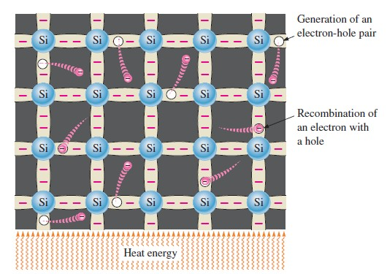
Conduction Electrons and Holes (Contd.)

Slide 17
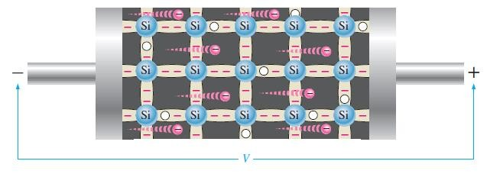
Electron Current
When a voltage is applied across a piece of intrinsic silicon, as shown in Figure, the thermally generated free electrons in the conduction band, which are free to move randomly in the crystal structure, are now easily attracted toward the positive end. This movement of free electrons is one type of current in a semiconductive material and is called electron current.

Slide 18
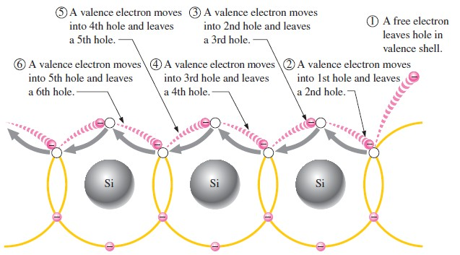
Hole Current
Another type of current occurs in the valence band, where the holes created by the free electrons exist. Electrons remaining in the valence band are still attached to their atoms and are not free to move randomly in the crystal structure as are the free electrons. However, a valence electron can move into a nearby hole with little change in its energy level, thus leaving another hole where it came from. Effectively the hole has moved from one place to another in the crystal structure, as illustrated in Figure. Although current in the valence band is produced by valence electrons, it is called hole current to distinguish it from electron current in the conduction band.

Slide 19
Doping
Since semiconductors are
generally poor
can be
conductors, their drastically increased
conductivity
by the controlled
addition of impurities to the intrinsic (pure) semiconductive material. This process, called
doping, increases the carriers (electrons or
number of current holes). The two
categories of impurities are n-type and p-type.

Slide 20
N-Type Semiconductor
To increase the number of conduction-band electrons in intrinsic silicon, pentavalent impurity atoms are added. These are atoms with five valence electrons such as arsenic (As), phosphorus (P), bismuth (Bi), and antimony (Sb).
As illustrated in Figure, each pentavalent atom (antimony, in this case) forms covalent bonds with four adjacent silicon atoms.
Four of the antimony atom’s valence electrons are used to form the covalent bonds with silicon atoms, leaving one extra electron. This extra electron becomes a conduction electron because it is not involved in bonding. Because the pentavalent atom gives up an electron, it is often called a donor atom.
The number of conduction electrons can be carefully controlled by the number of impurity atoms added to the silicon. A conduction electron created by this doping process does not leave a hole in the valence band because it is in excess of the number required to fill the valence band.

Slide 21
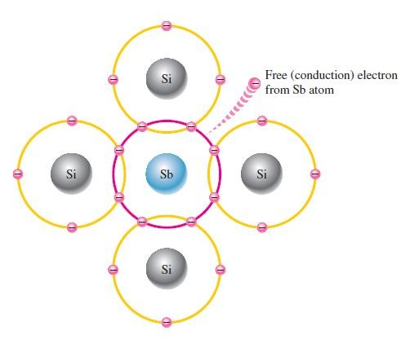
N-Type Semiconductor (Contd.)

Slide 22
N-Type Semiconductor (Contd.)
Majority and Minority Carriers Since most of the current carriers are electrons, silicon (or germanium) doped with pentavalent atoms is an n-type semiconductor (the n stands for the negative charge on an electron). The electrons are called the majority carriers in n-type material. Although the majority of current carriers in n-type material are electrons, there are also a few holes that are created when electron- hole pairs are thermally generated. These holes are not produced by the addition of the pentavalent impurity atoms. Holes in an n-type material are called minority carriers.

Slide 23
P-Type Semiconductor
To increase
the number of holes in intrinsic silicon, trivalent
impurity atoms are added.
These are atoms with three valence electrons such as boron (B), indium (In), and gallium (Ga).
As illustrated in Figure, each trivalent atom (boron, in this case) forms covalent bonds with four adjacent silicon atoms.
All three of the boron atom’s valence electrons are used in the covalent bonds; and, since four electrons are required, a hole results when each trivalent atom is added.
Because the trivalent atom can take an electron, it is often referred to as an acceptor atom. The number of holes can be carefully controlled by the number of trivalent impurity atoms added to the silicon.
A hole created by this doping process is not accompanied by a conduction (free) electron.

Slide 24
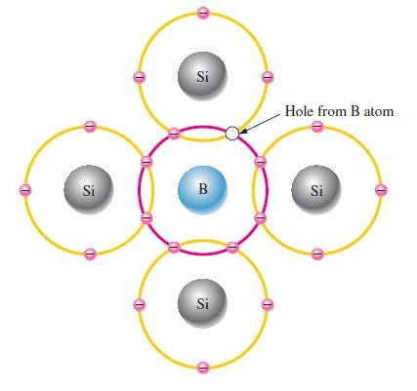
P-Type Semiconductor (Contd.)

Slide 25
P-Type Semiconductor (Contd.)
Majority and Minority Carriers Since most of the current carriers are holes, silicon (or germanium) doped with trivalent atoms is called a p-type semiconductor. The holes are the majority carriers in p-type material.
Although the majority of current carriers in p-type material are holes, there are also a few conduction-band electrons that are created when electron-hole pairs are thermally generated.
These conduction-band electrons are not produced by the addition of the trivalent impurity atoms.
Conduction-band electrons in p-type material are the minority carriers.

Slide 26
The PN Junction
A p-type material consists of silicon atoms and trivalent impurity atoms such as boron. The boron atom adds a hole when it bonds with the silicon atoms. However, since the number of protons and the number of electrons are equal throughout the material, there is no net charge in the material and so it is neutral.
An n-type silicon material consists of silicon atoms and pentavalent impurity atoms such as antimony. As you have seen, an impurity atom releases an electron when it bonds with four silicon atoms. Since there is still an equal number of protons and electrons (including the free electrons) throughout the material, there is no net charge in the material and so it is neutral.
If a piece of intrinsic silicon is doped so that part is n-type and the other part is p-type, a pn junction forms at the boundary between the two regions and a diode is created, as indicated in Figure. The p region has many holes (majority carriers) from the impurity atoms and only a few thermally generated free electrons (minority carriers). The n region has many free electrons (majority carriers) from the impurity atoms and only a few thermally generated holes (minority carriers).

Slide 27
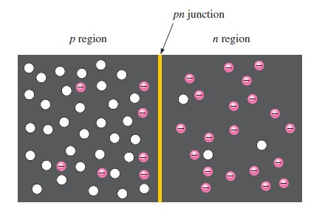
The PN Junction (Contd.)

Slide 28
The PN Junction (Contd.)
When the pn junction is formed, the n region loses free electrons as they diffuse across the junction.
This creates a layer of positive charges (pentavalent ions) near the junction. As the electrons move across the junction, the p region loses holes as the electrons and holes combine. This creates a layer of negative charges (trivalent ions) near the junction. These two layers of positive and negative charges form the depletion region, as shown in Figure.
The term depletion refers to the fact that the region near the pn junction is depleted of charge carriers (electrons and holes) due to diffusion across the junction. Keep in mind that the depletion region is formed very quickly and is very thin compared to the n region and p region.

Slide 29
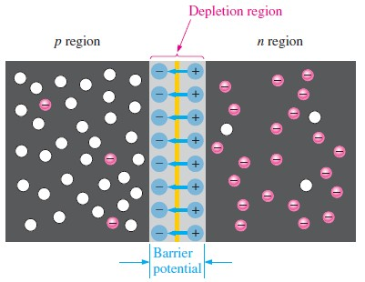
The PN Junction (Contd.)

Slide 30
The PN Junction (Contd.)
After the initial surge of free electrons across the pn junction, the depletion region has expanded to a point where equilibrium is established and there is no further diffusion of electrons across the junction.
This occurs as follows. As electrons continue to diffuse across the junction, more and more positive and negative charges are created near the junction as the depletion region is formed.
A point is reached where the total negative charge in the depletion region repels any further diffusion of electrons (negatively charged particles) into the p region (like charges repel) and the diffusion stops.
In other words, the depletion region acts as a barrier to the further
movement of electrons across the junction.

Slide 31
Barrier Potential
Any time there is a positive charge and a negative charge near each other, there is a force acting on the charges as described by Coulomb’s law.
In the depletion region there are many positive charges and many negative charges on opposite sides of the pn junction.
The forces between the opposite charges form an electric field, as illustrated in previous Figure by the blue arrows between the positive charges and the negative charges.
This electric field is a barrier to the free electrons in the n region, and energy must be expended to move an electron through the electric field.
That is, external energy must be applied to get the electrons to
move across the barrier of the electric field in the depletion region.

Slide 32
Barrier Potential (Contd.)
The potential difference of the electric field across the depletion region is the amount of voltage required to move electrons through the electric field.
This potential difference is called the barrier potential and is expressed in volts.
Stated another way, a certain amount of voltage equal to the barrier potential and with the proper polarity must be applied across a pn junction before electrons will begin to flow across the junction.
You have learned more about this when labs were performed.
The barrier potential of a pn junction depends on several factors, including the type of semiconductive material, the amount of doping, and the temperature.
The typical barrier potential is approximately 0.7 V for silicon and
0.3 V for germanium at 25⁰𝐶.

Slide 33
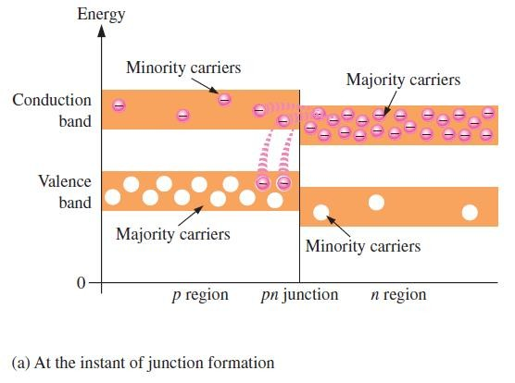
Energy Diagram

Slide 34
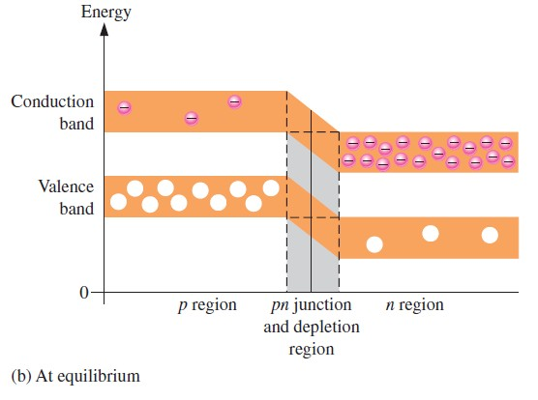
Energy Diagram

